Slide 1
Learning to Optimize Neural Nets

Slide 2
Contents
(1.1) the methodology (the math)
(1.2) related works
(1.3) the algorithm
(1.4) the experiment
(1.5) the result plots generated from the software built by the candidate, and the plots in the original paper
(1.6) results discussion

Slide 3
1.1 the methodology
In this study, we investigate how to develop a training algorithm for shallow neural nets. For current reinforcement learning algorithms, such high-dimensional stochastic optimization problems pose interesting challenges. The learned optimization algorithm consistently outperforms other well-known optimization algorithms, even on tasks that have not yet been seen, and is resistant to changes in the stochasticity of gradients and the neural net architecture, which we demonstrate by developing an extension that is appropriate for learning optimization algorithms in this environment.
In more detail, we demonstrate how an optimization algorithm trained using the suggested method on the issue of training a neural network on MNIST generalizes to the issues of training neural networks on the Toronto Faces Dataset, CIFAR-10, and CIFAR-100.

Slide 4
The core idea behind machine learning is that discovering patterns automatically from data is typically preferable to painstakingly creating rules by hand. This data-driven strategy has paid off: machine learning techniques are being used in many other fields, including AI and beyond. The design of the tools that support machine learning itself is one area where machine learning has notably avoided entering.
Optimization algorithms are one of the most often utilized tools in machine learning. An optimization algorithm is typically viewed as a "black box" that accepts a model that we create and the data that we gather and produces the ideal model parameters. The optimization algorithm itself mostly remains static; human experts are required to labor through numerous iterations of theoretical study and practical validation in order to create a more effective optimization method.

Slide 5


The math
A general "sequential" neural network can be expressed as
Where
The 𝐴𝑖 are matrices and the 𝑏𝑖 are bias vectors. Typically the 𝑅𝑖 are the same for all the layers (typically ReLU) except for the last layer, where 𝑅𝑖 is just is just the identity function
Note: In clever architectures, like convolutional neural networks, the 𝐴𝑖's become sparse matrices (most of there parameters are fixed to equal zero)

Slide 6
1.2 related works
The line of work on learning optimization algorithms is fairly recent. Li & Malik (2016) and Andrychowicz et al.(2016) were the first to propose learning general optimization algorithms. Li & Malik (2016) explored learning task-independent optimization algorithms and used reinforcement learning to learn the optimization algorithm, while Andrychowicz et al. (2016) investigated learning task-dependent optimization algorithms and used supervised learning.
In the special case where objective functions that the optimization algorithm is trained on are loss functions for training other models, these methods can be used for “learning to learn” or “meta-learning”. While these terms have appeared from time to time in the literature (Baxter et al., 1995; Vilalta & Drissi, 2002; Brazdil et al., 2008; Thrun & Pratt, 2012), they have been used by different authors to refer to disparate methods with different purposes. These methods all share the objective of learning some form of meta-knowledge about learning, but differ in the type of meta-knowledge they aim to learn. We can divide the various methods into the following three categories.

Slide 7
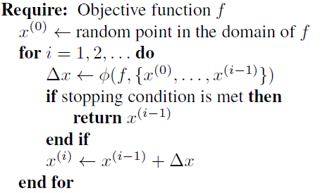
1.3 the algorithm
General structure of optimization algorithms
Each optimization algorithm is primarily defined by its update formula Φ, which results in distinct optimization methods depending on the value of Φ chosen. Therefore, we can learn an optimization method by studying Φ.
A Markov decision process (MDP) can be used to conceptualize an optimization algorithm, where the state is represented by the current iteration, the action is represented by the step vector ∆x, and the policy is represented by the update formula Φ. As a result, the learning Φ problem can be reduced to a problem of policy search.

Slide 8
In each iteration, the algorithm takes a step ∆x and uses it to update the current iterate ᵪ(i). In hand-engineered optimization algorithms, ∆x is computed using some fixed formula that depends on the objective function, the current iterate and past iterates. Often, it is simply a function of the current and past gradients.
In this study, we extend the approach that was previously described in order to learn optimization methods for high-dimensional stochastic situations. We utilize it to learn an optimization algorithm for training shallow neural nets, and we demonstrate that it performs better than both a learnt optimization algorithm and a popular hand-engineered optimization algorithm used in other studies and research.
In addition, we show that our optimization technique generalizes to training on other datasets with statistically substantially different from MNIST, such as the Toronto Faces Dataset, CIFAR-10, and CIFAR-100.

Slide 9
1.4 the experiment
To distinguish it from baselevel training, we will refer to optimization algorithm training as "meta-training" for the sake of clarity.
We meta-trained an optimization algorithm on a single objective function, which is equivalent to training a two-layer neural net with 48 input units, 48 hidden units, and 10 output units on a randomly projected and normalized version of the MNIST training set with dimensionality 48 and unit variance in each dimension. We used a recurrent neural net to model the optimization algorithm with a single layer of 128 LSTM cells..

Slide 10
For computing stochastic gradients and objective values, we used a time horizon of 400 iterations and a mini-batch size of 64. The optimization algorithm is evaluated based on its ability to generalize to previously unseen objective functions, which correspond to the problems of training neural nets on various tasks/datasets.
The learned optimization algorithm is evaluated on three datasets: the Toronto Faces Dataset (TFD), CIFAR-10, and CIFAR-100.
These datasets were chosen because they differ greatly from MNIST and each other: TFD has 3300 grayscale images with little variation and seven different categories, whereas CIFAR-100 has 50,000 color images with varying appearance and 100 different categories.

Slide 11
The training objective function is used to tune all algorithms.
This entails selecting the best hyperparameters for hand-engineered algorithms and meta-training on the objective function for learned algorithms. We compare stochastic gradient descent, momentum, conjugate gradient, L-BFGS, ADAM, AdaGrad, and RMSprop to seven hand-engineered algorithms.
Furthermore, we compare to an optimization algorithm meta-trained on the same training objective function (training two-layer neural net on randomly projected and normalized MNIST) using the method described in (Andrychowicz et al., 2016) under the same conditions (a time horizon of 400 iterations and a mini-batch size of 64).

Slide 12
We start by analyzing how different optimization techniques perform when used with goal functions that are similar.
The optimization issues taken into account are those related to training neural networks with the same number of input and hidden units (48 and 48) as those employed during meta-training.
The number of categories in each dataset affects the number of output units.
The mini-batch size that we employ is the same as that utilized for meta-training. Predicted Step Descent, the optimization algorithm meta-trained with our technique, reliably descends to the optimum the quickest across all datasets.
Other algorithms, however, are less reliable, and their relative standing fluctuates depending on the dataset.
This shows that despite training on just one objective function, which is connected to a very particular data distribution that defines MNIST, Predicted Step Descent has developed the ability to be resilient to changes in the data distributions.
It's also noteworthy that, despite the algorithm's meta-training and strong performance on CIFAR, it fails to achieve the optimum on TFD.

Slide 13
Next, we modify the neural network's architecture to investigate if Predicted Step Descent generalizes to the modified architecture.
We increase the input units to 100 and the hidden units to 200, which results in an approximately 8-fold increase in the number of parameters.
Despite not having been trained to optimize neural nets of this architecture, Predicted Step Descent consistently beats competing algorithms on each dataset.
Intriguingly, it first showed some oscillation on TFD and CIFAR-10, but recovered rapidly and passed other methods, resembling a phenomena observed for low-dimensional optimization problems. This shows that it has mastered the ability to recognize when it is underperforming and knows how to adjust course accordingly.

Slide 14
Now, we look at how resistant Predicted Step Descent is to gradient stochasticity.
In order to do this, we examine how well it performs when the mini-batch size is decreased from 64 to 10 on the original architecture with 48 input and hidden units as well as the expanded architecture with 100 input units and 200 hidden units.
Predicted Step Descent still outperforms every other algorithm on the original architecture and manages the extra stochasticity very well.
Conjugate gradient, on the other hand, and L2LBGDBGD, to a lesser extent, struggled to deal with the increased stochasticity on TFD and CIFAR-10. Both diverged in the first situation, whereas both were making slow progress toward the ideal in the second.

Slide 15
Predicted Step Descent had some substantial oscillations on TFD and CIFAR-10 on the expanded architecture, but it still managed to outperform all other algorithms in terms of objective value.
The oscillations of many hand-engineered algorithms were also substantially larger than before, indicating that the optimization problems are fundamentally more difficult.
L2LBGDBGD diverged on these two datasets rather fast.
Finally, we attempt doubling the number of iterations and find that Predicted Step Descent continues to behave properly even after being trained over a time horizon of 400 iterations.

Slide 16
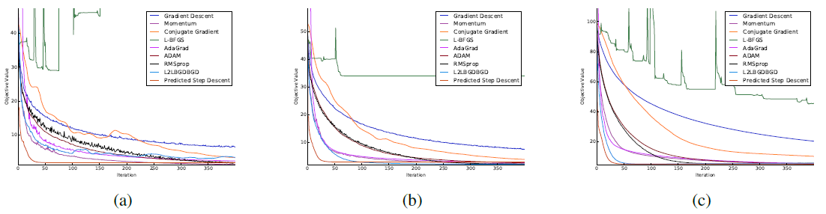
1.5 the result plots generated from the software built by the candidate, and the plots in the original paper
1.5.1 The plots in the original paper
Above figure shows, Comparison of the various hand-engineered and learned algorithms on training neural nets with 48 input and hidden units on (a) TFD, (b) CIFAR-10 and (c) CIFAR-100 with mini-batches of size 64. The vertical axis is the true objective value and the horizontal axis represents the iteration.

Slide 17
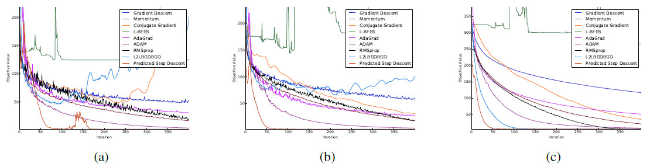
Above figure shows, Comparison of the various hand-engineered and learned algorithms on training neural nets with 100 input units and 200 hidden units on (a) TFD, (b) CIFAR-10 and (c) CIFAR-100 with mini-batches of size 64. The vertical axis is the true objective value and the horizontal axis represents the iteration

Slide 18
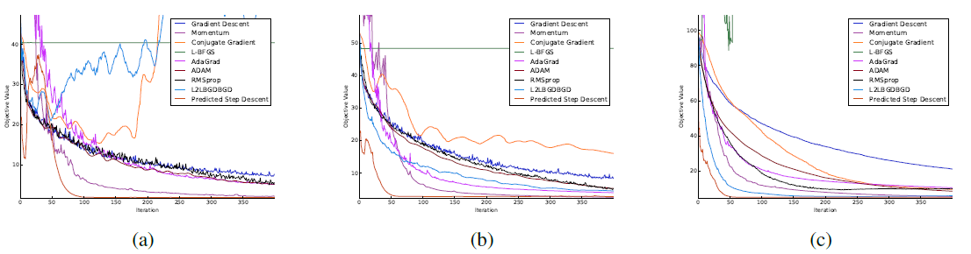
Above figure shows, Comparison of the various hand-engineered and learned algorithms on training neural nets with 48 input and hidden units on (a) TFD, (b) CIFAR-10 and (c) CIFAR-100 with mini-batches of size 10.
The vertical axis is the true objective value and the horizontal axis represents the iteration.

Slide 19
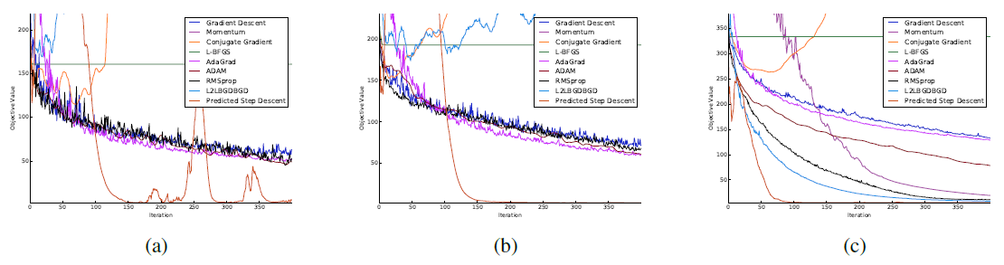
Above figure shows, Comparison of the various hand-engineered and learned algorithms on training neural nets with 100 input units and 200 hidden units on (a) TFD, (b) CIFAR-10 and (c) CIFAR-100 with mini-batches of size 10.
The vertical axis is the true objective value and the horizontal axis represents the iteration.

Slide 20
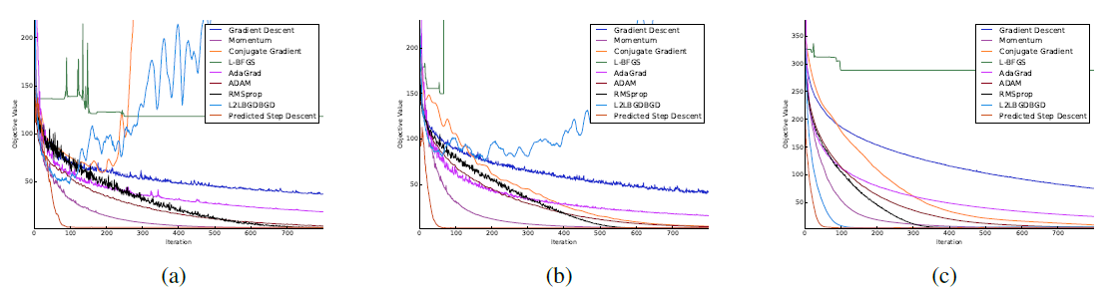
Above figure shows, Comparison of the various hand-engineered and learned algorithms on training neural nets with 100 input units and 200 hidden units on (a) TFD, (b) CIFAR-10 and (c) CIFAR-100 for 800 iterations with mini-batches of size 64.
The vertical axis is the true objective value and the horizontal axis represents the iteration.

Slide 21
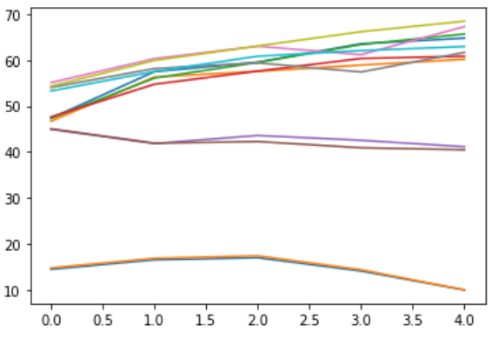
1.5.2 The result plots generated from the software built by the candidate
Above figure shows, Comparison of the various hand-engineered and learned algorithms on training neural nets
Initially, both the training and validation losses seem to decrease over time. However, if we train the model for long enough, we will notice that the training loss continues to decrease, while the validation loss stops decreasing, and even starts to increase after a certain point

Slide 22
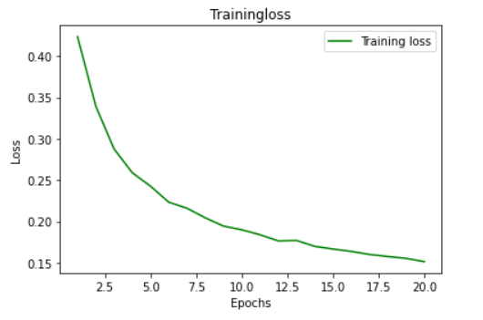
For my case, we trained just for 20 epochs with stochastic gradient descent optimization algorithm. From the look of the curve, it shows that there is a possibility of the curve going lower (loss reducing), thus increasing the model performance

Slide 23
1.6 results discussion
We described a fresh approach to teaching optimization methods for complex stochastic issues.
We used the technique to discover a training algorithm for shallow neural nets.
We demonstrated that the algorithm developed using our approach to train neural networks on the MNIST problem generalizes to difficulties of training neural networks on unrelated tasks or datasets, such as the Toronto Faces Dataset, CIFAR-10, and CIFAR-100. Researcher used CIFAR-10 for the software
We also showed that the learned optimization technique is resistant to changes in the neural network design and the stochasticity of gradients.

Slide 24
After the training of these algorithms, we decided to use stochastic gradient descent. Neural networks pretrained using stochastic gradient descent, thus we have to choose a loss function, which will assist in optimization.
Typically, a neural network model is trained using the stochastic gradient descent optimization algorithm and weights are updated using the backpropagation of error algorithm.
The “gradient” in gradient descent refers to an error gradient. The model with a given set of weights is used to make predictions and the error for those predictions is calculated.
The gradient descent algorithm seeks to change the weights so that the next evaluation reduces the error, meaning the optimization algorithm is navigating down the gradient (or slope) of error.

Slide 25
THANK YOU

